Slide 1
Flight Delay Prediction
By Natalie, Teagan, Benny
https://github.com/bgrullon/FlightDelayPrediction

Slide 2

Agenda
01
Team Introduction
02
The Topic and Questions
03
Data Sourcing, EDA, and ETL
04
Analysis and Visualizations
05
Conclusion and Prediction

Slide 3
Topics & Questions
Natalie

Slide 4
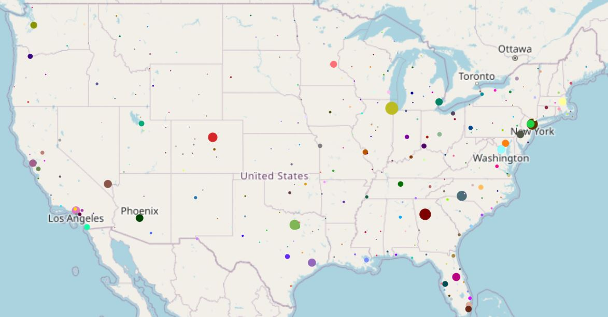



Flight Delays in the US
Size is based on total number of delays.

Slide 5
Data ETL & EDA
Benny

Slide 6
Flight and Weather Data
Flight Data for 3 Days | Flight Date | Arrival Airport | Departure Airport | Arrival Time | Departure Time | Delay
 | 2018-07-20 | ATL | LAX | 0900 | 0500 | -15.0
 | 2018-07-23 | BOS | DAL | 1545 | 1120 | -35.0
 | 2018-07-24 | AUS | BWI | 1830 | 1345 | -12.0
Weather Data for 3 Days | Time | Temperature (F) | Precipitation | Windspeed | Dew Point | City
 | 0900 | 44 | 0.01 | 6.3 | 73.5 | Albuquerque, New Mexico
 | 1300 | 58 | 0.0 | 10.1 | 66.3 | Dallas, Texas
 | 1700 | 70 | 0.03 | 7.1 | 56.6 | Denver, Colorado
Airline Data
Weather Data
Data from 2009 till 2018 was found on Kaggle and imported as a CSV via Kaggle’s API.
Historical Data was retrieved from Visual Crossings API.

Slide 7
Statistical Analysis
Delay Temperature Windspeed Precipitation Dew | Mean | Median | Mode | P Value | Std Deviation | Statistics | Lower Q | Upper Q | Inter Q | Lower T | Upper T
 | 50.137786 | 25.0 | 2.0 | 0.000000e+00 | 73.442333 | 33556.030626 | 4.0 | 68.0 | 64.0 | 4.0 | 68.00
 | 78.726377 | 78.5 | 70.2 | 1.397811e-127 | 8.846570 | 584.186798 | 72.9 | 83.65 | 10.75 | 72.9 | 83.68
 | 7.497486 | 7.1 | 5.8 | 3.838786e-181 | 4.095088 | 830.845491 | 4.7 | 10.10 | 5.40 | 4.7 | 10.10
 | 0.007880 | 0.0 | 0.0 | 0.000000e+00 | 0.039876 | 53035.083887 | 0.0 | 0.00 | 0.00 | 0.0 | 0.00
 | 65.096398 | 66.0 | 67.9 | 0.000000e+00 | 8.204313 | 2297.675839 | 59.9 | 72.00 | 12.10 | 59.9 | 72.00
Delay Temperature Windspeed Precipitation Dew | Mean | Median | Mode | P Value | Std Deviation | Statistics | Lower Q | Upper Q | Inter Q | Lower T | Upper T
 | 50.137786 | 25.0 | 2.0 | 0.000000e+00 | 73.442333 | 33556.030626 | 4.0 | 68.0 | 64.0 | 4.0 | 68.00
 | 78.726377 | 78.5 | 70.2 | 1.397811e-127 | 8.846570 | 584.186798 | 72.9 | 83.65 | 10.75 | 72.9 | 83.68
 | 7.497486 | 7.1 | 5.8 | 3.838786e-181 | 4.095088 | 830.845491 | 4.7 | 10.10 | 5.40 | 4.7 | 10.10
 | 0.007880 | 0.0 | 0.0 | 0.000000e+00 | 0.039876 | 53035.083887 | 0.0 | 0.00 | 0.00 | 0.0 | 0.00
 | 65.096398 | 66.0 | 67.9 | 0.000000e+00 | 8.204313 | 2297.675839 | 59.9 | 72.00 | 12.10 | 59.9 | 72.00
Arrival & Departure Data Summary
P Value and Statistics were results from states Normal Test.

Slide 8
Delay vs Windspeed
Teagan

Slide 9
Flight Delays Vs Windspeed
Analysis
Correlation Coefficient
0.113 Arrival Delay
0.101 Departure Delay
R-squared Value
~0.00789 Arrival Delay
~0.0127 Departure Delay
Airport with Most/Least Windspeed
Most: ABQ at 18.37 MPH
Least: LIT at 0.215 MPH

Slide 10
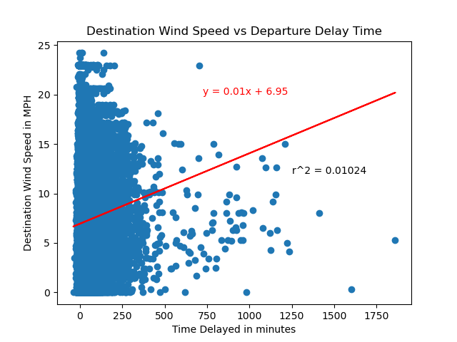

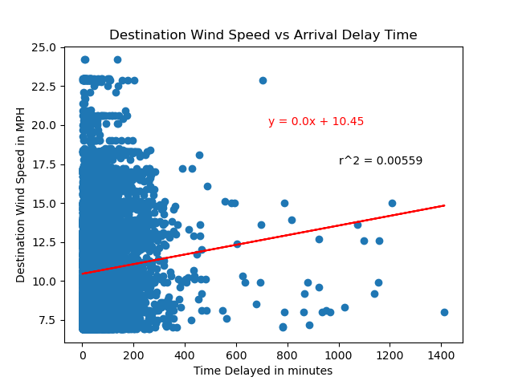

Windspeed Visualizations

Slide 11
Delay vs Precipitation
Natalie

Slide 12
Flight Delays Vs Precipitation
Analysis
Correlation Coefficient
0.06 Arrival Delay
0.05 Departure Delay
R-squared Value
~0.0042 Arrival Delay
~0.0026 Departure Delay
Airport with Most/Least Precipitation
Most: ATL at 1.151 inches
Least: AUS at 0.0 inches

Slide 13
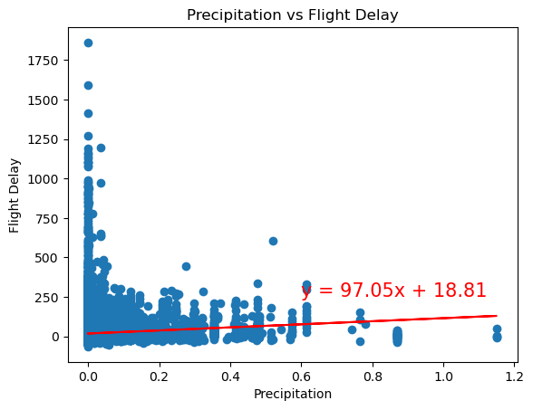
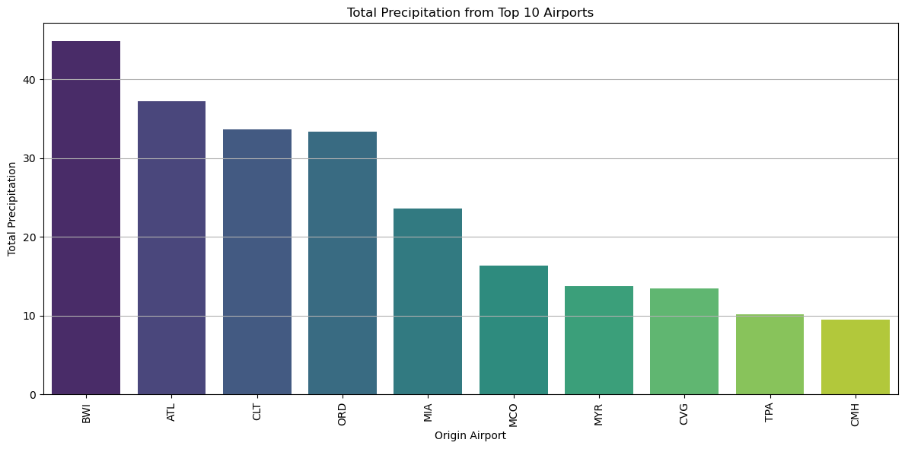
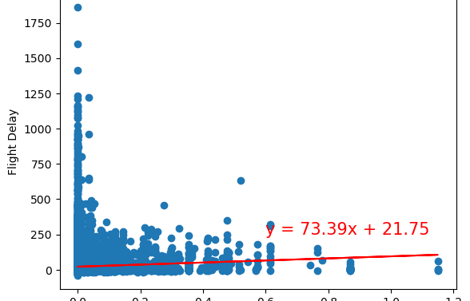

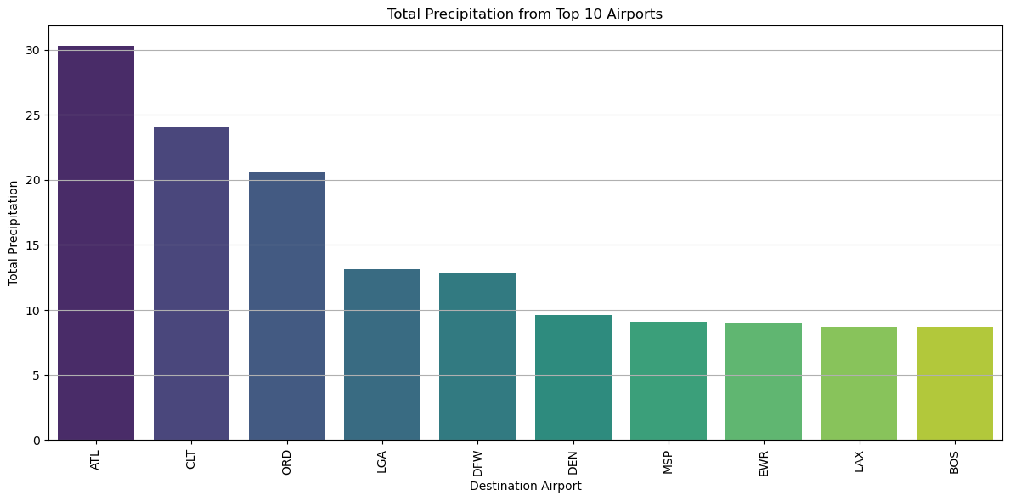
Precipitation Visualizations
You can simply impress your audience and add a unique zing and appeal to your Presentations. Easy to change colors, photos and Text. Get a modern PowerPoint Presentation that is beautifully designed. You can simply impress your audience and add a unique zing and appeal to your Presentations.

Slide 14
Delay vs Temperature
Benny

Slide 15
Flight Delays Vs Temperature
Analysis
Correlation Coefficient Temperature
-0.01 Arrival Delay
-0.03 Departure Delay
Correlation Coefficient Dew Point
0.1 Arrival Delay
0.1 Departure Delay
Formula for Dew Point Temperature
T(dp) = T - ((100 - RH)/5)
T = Temperature
RH = Relative Humidity

Slide 16

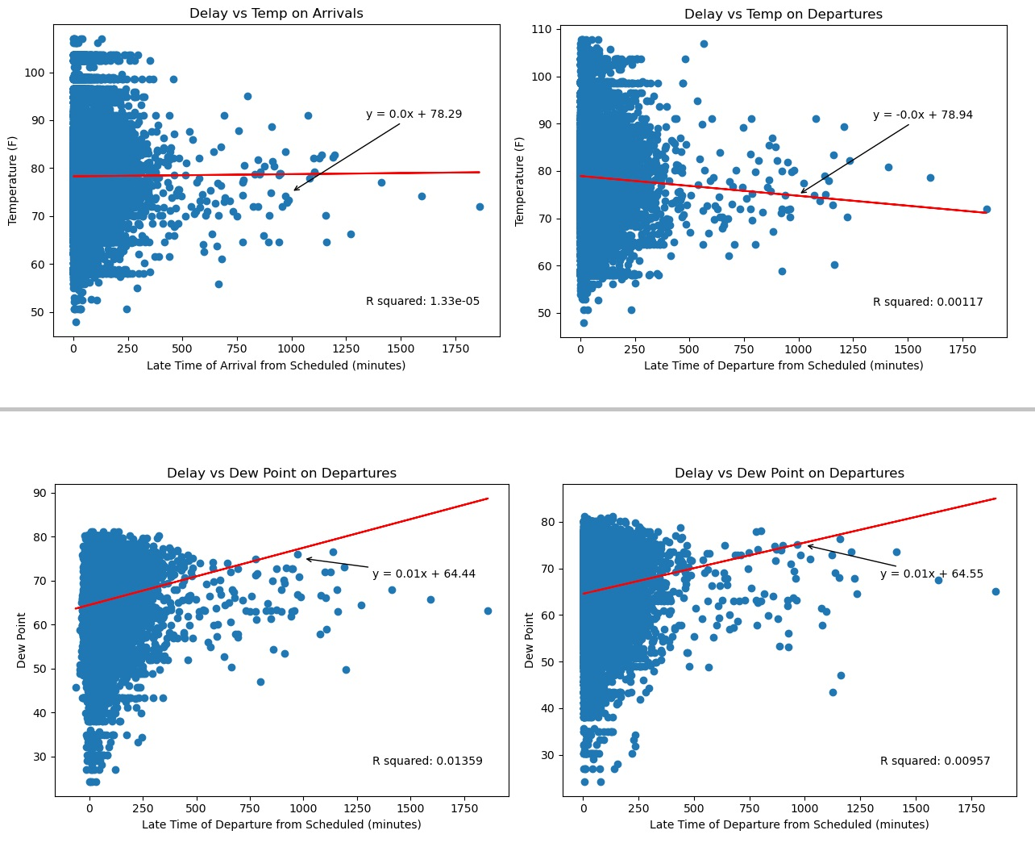

Visualizations
Temperature Max
107.8 Austin, Texas
548 Delays
Dew Point Max
81.1 Dallas-Fort Worth, Texas
2,505 Delays

Slide 17
Prediction
Benny

Slide 18
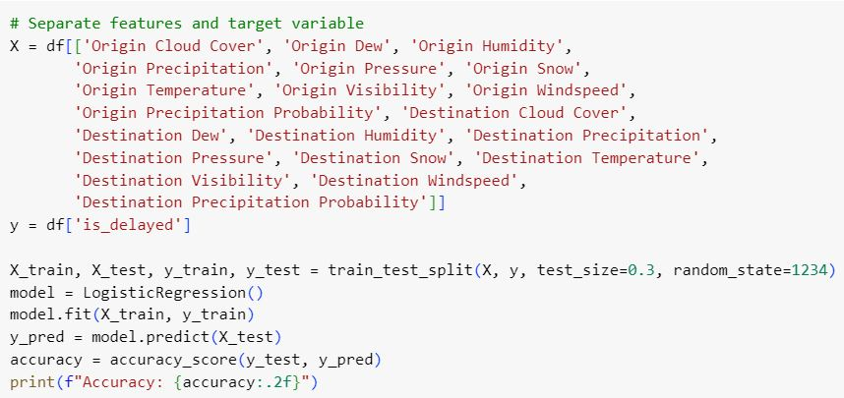
Logistic Regression
Logistic Regression Model
Weather Data as Feature
Binary Delay as Target
Accuracy_Score: 61%
GridSearchCV: 61%

Slide 19
Our Prediction
1. Gather Params
2023-07-31
1835
Denver, Colorado
Atlanta, Georgia
2. Make Request
Insert params into function
Make request to Weather API
4. Make Prediction
3. Format Response
Get Boolean response from model
Conditionally reply back to User
Format data for Departure and Arrival
Insert in Pre-Trained Model

Slide 20
Thank you

